Slide 1

Sprint Review and Retrospective
Rishawna Snow
4/16/2026

Slide 2
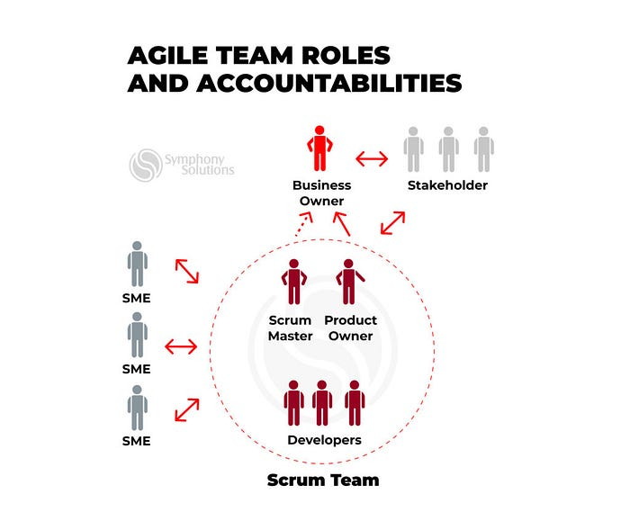
Agile Roles
Product Owner: Manages backlog and prioritizes work
Scrum Master: Facilities Scrum and removes blockers
Development Team: Build and delivers products increments

Slide 3
Agile Phases
Sprint Planning: Select tasks from backlog
Development: Build features in sprints
Testing: Continuous validation
Review: Present completed work
Retrospective: Improve process

Slide 4
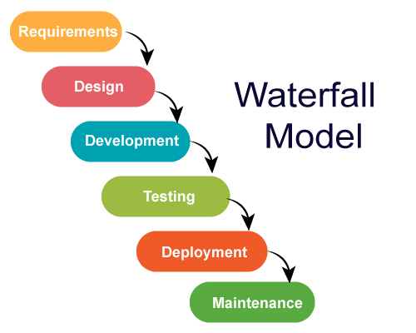
Waterfall Model
Linear Process:
Requirements
Design
Development
Testing
Deplyment
Changes are difficult once a phase is complete.

Slide 5
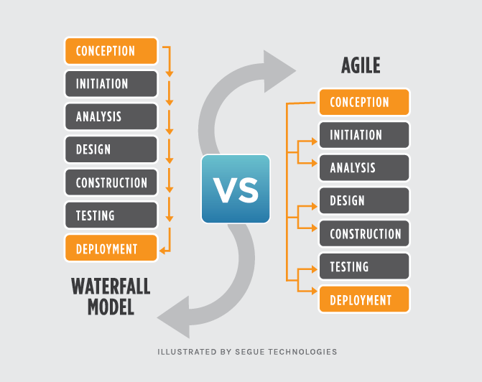
Agile vs Waterfall
Agile: Flexibilty, iterative, continuous feedback
Waterfall: Structured , sequential, limited flexibility

Slide 6

Choosing the Right Approach
Consider: Project complexity
Need for flexibility
Stakeholder involvement
Timeline
(Agile worked best for SNHU Travel due to changing requirements)

Slide 7
References
Schwaber, K., & Sutherland, J. (2020). The Scrum Guide.
VersionOne. (2021). State of Agile Report
PMI. (2021). Pulse of the Profession.
EBSCO eBook (Scrum framework source)
Segue Tech

